Slide 1

Microsoft GDPR Detailed Assessment – v3.0 April 2018
Pre-Engagement Meeting
<your name>
This presentation is intended to provide an overview of GDPR and is not a definitive statement of the law.

Slide 2
Version History & Updates
hidden slide
Please keep this page up to date!
V | Date | Who | What
1.2 | 30-06-2017 | Various | First public version delivered.
1.3 | 13-07-2017 | François van Hemert | Changed name to reflect updates in delivery guide: Original name: 01 - Microsoft GDPR Detailed Assessment - Engagement Overview - v1.2 New name: 01 - Microsoft GDPR Detailed Assessment - Pre Engagement Presentation - v1.3 Various updates to align with delivery guide. Added section on Assessment tool; formatting & layout; speaker notes
1.8 | 12-09-2017 | François van Hemert | Minor changes/updates
1.9 | 18-09-2017 | François van Hemert | Submitted for CELA review
2.0 | 04-10-2017 | François van Hemert | Published version
3.0 | 29-03-2018 | François van Hemert | Added Compliance manager integration
Notes:
This deck is frequently updated with new insights and feedback from the field. Please keep version history up to date.

Slide 3
Feedback
hidden slide
We want to hear from you about how you are using the tools and assets, what works, and what does not.
If you feel there is anything missing, or any other feedback that you would like to provide, please let us know.
Yammer Community Site: https://aka.ms/gdprcommunity
Notes:
P

Slide 4
Required Partner Preparation
hidden slide
In order to deliver this presentation successfully you need to know the following:
All slides in the deck with the “example” ribbon show examples. Don’t show the examples to the customer; they are just there to help you understand the intention of the slide. Customize the examples to match the specific engagement you are delivering, then remove the Example tag
If you intend to leave the presentation with the customer, remove all hidden slides and preferably deliver as a PDF document
Download the latest version of the toolkit here: https://aka.ms/gdprtoolbox
Make sure to have the following people in the workshop:
Anyone needed from your organization
Project Executive Sponsor
Project Manager/Coordinator
Enterprise/Compliance Architects
Privacy & Compliance Specialists

Slide 5
Microsoft GDPR Detailed Assessment
hidden slide
Workshop | Description | Resources
Step 1
Pre-engagement meeting (on-line) | Introduction to the Microsoft GDPR Detailed assessment, discuss upcoming activities, align expectations and timelines. High level introduction to GDPR. Preview of the Microsoft GDPR Detailed Assessment questions to help identify the customer representatives that will assist in answering. | 00 - Microsoft GDPR Detailed Assessment - Delivery Guide 01 - Microsoft GDPR Detailed Assessment – Pre Engagement Presentation (this deck)
Step 2
Engagement Kickoff (on-site) | Kick off meeting to introduce (new) team members, brief the team on upcoming activities. Confirm meeting schedules and locations | 00 - Microsoft GDPR Detailed Assessment - Delivery Guide 02 - Microsoft GDPR Detailed Assessment – Engagement Kickoff Presentation
GDPR Detailed Assessment | Complete discussion of the questions contained within the Microsoft GDPR Detailed Assessment | 00 - Microsoft GDPR Detailed Assessment - Delivery Guide 03 - Microsoft GDPR Detailed Assessment – Detailed Assessment tool
Outcome Analysis and Write-Up | Analyze and document results of the assessment, prepare the close out presentation. | 00 - Microsoft GDPR Detailed Assessment - Delivery Guide 04 - Microsoft GDPR Detailed Assessment – Closeout Presentation
Step 3
Close-out presentation | Present the findings from the assessment to the customer and define next steps and if possible a roadmap towards GDPR compliance. | 00 - Microsoft GDPR Detailed Assessment - Delivery Guide 04 - Microsoft GDPR Detailed Assessment – Closeout Presentation
Notes:
The detailed assessment is built on three steps that are discussed and detailed in the “00 - Microsoft GDPR Detailed Assessment - Delivery Guide”
For detailed information and background refer to the delivery guide
This presentation is intended to be used during the online Pre-engagement meeting.

Slide 6
Partner Call to Action
hidden slide
Target audience: Customers with GDPR compliance requirements.
Customer role: all roles that are relevant to the Microsoft GDPR Detailed Assessment engagement—most likely, an audience of business decision makers including Data Privacy Officers, Chief Information Security Officer, Legal & Compliance, and Human Resources.
We want to answer the following questions:
What is the GDPR?
What is the Microsoft perspective on the GDPR?
What is the Microsoft GDPR Detailed Assessment?
What are the goals of the workshop?
What is the workshop schedule?

Slide 7
Intended usage
This model is a question-driven assessment tool for preparing for the General Data Protection Regulation (GDPR) (Regulation (EU) 2016/679). The tool is intended to be used by Microsoft partners to assist customers in identifying where they are on the journey to GDPR readiness. Output from the tool includes identification of gaps in customer readiness and recommendations to consider for closing any gaps. Recommendations are organized into the categories People, Process and Technology.
Disclaimer
This GDPR Detailed Assessment is intended to assist organizations with assessing their GDPR compliance progress. This GDPR Detailed Assessment is provided for general public informational purposes only. Any results, scoring or recommendations produced by the GDPR Detailed Assessment should not be relied upon to determine how GDPR applies to an organization or an organization’s compliance with GDPR, and they do not constitute legal advice, certifications or guarantees regarding GDPR compliance. Instead, we hope the GDPR Detailed Assessment identifies technologies and additional steps that organizations can implement to simplify their GDPR compliance efforts. The application of GDPR is highly fact-specific. We encourage all organizations using this GDPR Detailed Assessment to work with a legally qualified professional to discuss GDPR, how it applies specifically to their organization, and how best to ensure compliance.
MICROSOFT MAKES NO WARRANTIES, EXPRESS, IMPLIED, OR STATUTORY, AS TO THE INFORMATION IN THIS GDPR DETAILED ASSESSMENT. Microsoft disclaims any conditions, express or implied, or other terms that use of the Microsoft products or services will ensure the organization’s compliance with the GDPR. This GDPR Detailed Assessment is provided “as-is.” Information and recommendations expressed in this GDPR Detailed Assessment may change without notice.
This GDPR Detailed Assessment does not provide the user with any legal rights to any intellectual property in any Microsoft product or service. Use of the tool is for internal, reference purposes only; however, Microsoft partners may distribute the GDPR Detailed Assessment to their customers for such customers’ internal, reference purposes only. Any distribution of the GDPR Detailed Assessment by a Microsoft partner to its customers must include terms consistent with those set forth in this disclaimer.
© 2017 Microsoft. All rights reserved
Notes:
Discuss the disclaimer and its intention with your customer. It is important to emphasize the information contained in the disclaimer.

Slide 8
Agenda
1
Introduction
2
Introducing the Microsoft GDPR Detailed Assessment
3
Engagement Overview
4
The Microsoft GDPR Assessment Tool
5
Project Governance

Slide 9
Introduction

Slide 10

On-site Workshop Introduction
The purpose of this meeting is to:
Introduce the GDPR Detailed Assessment
Review and finalize on-site workshop schedule and logistics
Identify customer responders
Introduce the GDPR Detailed Assessment tool
Define Project Governance
Notes:
Customer facing slides to introduce the assessment offering.
The pre-engagement meeting is focused on providing a high level introduction of the upcoming activities and sort out logistics.
Talking points:
Introduce the GDPR Detailed Assessment → this deck will introduce the assessment and provide a high level overview of the activities
Review and finalize on-site workshop schedule and logistics → we need to agree on a start date, and arrange meeting rooms
Identify customer responders → identifying the right people to answer the assessment questions is essential for the engagement. Advice is to keep the number of responders to a minimum and stress the importance of “the right people”
Introduce the GDPR Detailed Assessment tool → to prepare the customer and align expectations we will share some detail of the assessment tool. DO NOT promise the customer to send the tool prior to the engagement.
Project governance → although this is only a two day engagement it is important that we identify possible risks and understand who is responsible to address
Risks and Issues → as mentioned above, having the right people available at the right time is crucial to the engagement.
Success Criteria → discuss the success criteria with your customer. Are you aligned and does the customer have the right expectation?
Try to avoid too much detail during this call, the project kick-off meeting is the right time to answer all detailed questions.

Slide 11

Team Introductions
Name
Please share your name and where are you based?
Role
Please share your role in the company, which business unit or team you are part of, what other roles have you had? (Internal/External)
Expectations
Please share your expectations of the session?
Notes:
Ask everyone on the meeting to present themselves.
Note takers should capture this information in the provided template.
Limit to 30 seconds per person.
It is important to understand the role of the attendees, this will help in identifying the right responders for the questionnaire.

Slide 12
Introducing the Microsoft GDPR Detailed Assessment

Slide 13


Assessment opportunities
Identify GDPR compliance gaps
Identify maturity along key GDPR scenarios
Identify potential data security and compliance challenges
Determine the current state of personal data security. Discuss and create an actionable data security roadmap for the customer
Notes:
The journey to GDPR compliance starts with understanding the maturity of people, processes and technology at the customer .
The Microsoft GDPR detailed Assessment is focused on this.
It is important to understand that the assessment will not access (personal) data or analyze it, the assessment will look at the people, process and technology the customer uses to work with the data.

Slide 14




Assessment objectives
Understand Customer GDPR compliance objectives
Gain a common understanding of compliance objectives and GDPR requirements
Assess Customer GDPR maturity level
Assess customer’s preparedness to execute on Discover, Manage, Protect, & Report activities
Create a GDPR compliance roadmap
Provide a prioritized and actionable GDPR remediation checklist and roadmap, ready for legal/advisory review
Notes:
Use the information in the delivery guide to provide more background on the structure of the assessment and the objectives.
Briefly explain the objectives for the assessment:
Understand what the customer wants and needs to become GDPR compliant
Assess the current maturity level, do they for example have processes in place to protect data or report on data breaches?
The outcome of the assessment will be a list of actionable items. Addressing these will help the customer on its journey to GDPR compliance
It is important that the outcome of the assessment and the actions defined are reviewed with a legal focus

Slide 15

Out of Scope
Technical designs or product implementations
Proof of concepts or labs
Recommendations for non-Microsoft technology
Notes:
If partner is providing recommendations for non-Microsoft technology, the slide should be updated.
All activities are focused on assessing maturity of people, process and technology with respect to the GDPR, during the assessments suggestions and activities will be defined to optimize existing or implement new processes and technology. Implementing these suggestions however is not part of this assessment.

Slide 16
Outcomes
From here to there
Where are you today?
Where do you want to go?
Where do you need to go?
How will you get there?
What does success mean to you?
Workshop Outcome
Know and understand GDPR maturity based on the Microsoft GDPR Detailed Assessment
Prioritized, actionable next steps and roadmap towards GDPR compliance
Notes:
The assessment is the start of the journey towards GDPR compliancy. It clearly charts the current situation and will outline actions that will assist in becoming GDPR compliant.

Slide 17



Your responsibilities
Help to Complete Microsoft GDPR Detailed Assessment questions
Provide access to key participants during the assessment
Determine & schedule appropriate audience prior to workshops. This will often include legal, advisory, and senior decision making roles.
Provide executive sponsor
A single executive sponsor is required to oversee and support the engagement
Notes:
The assessment can only be successful if the right people are available to help answer the assessment questions. The quality of the assessment and the usability of the outcome will greatly depend on the accuracy and detail of the answers provided. Having an executive sponsor will help people free time in their calendars and prioritize the assessment activities.

Slide 18
Engagement Overview

Slide 19
Workflow and Schedule
Example
Now
Pre-Engagement meeting
This week
Secure executive sponsor and align resources to complete the Microsoft GDPR Detailed Assessment
Two weeks from now
Complete the Microsoft GDPR Detailed Assessment,
analyze results and prepare recommendations
Optional
Real-time assessment of the GDPR compliance posture for customers assets in the Microsoft cloud using Compliance Manager
Three weeks from now
Present the findings, discuss remediation and next steps. Deliver prioritized roadmap
Notes:
The time line provided is indicative and needs to be tailored to customers requirements and availability.
The pre-engagement meeting is there to set things in motion and to start the process of identifying the right people and take care of logistics. This usually takes a week.
The actual on-site engagement will start one to two weeks after the online re-engagement meeting and will take an average of 2 on site days.
After completion a close out meeting will be conducted in which the outcome of the assessment will be presented.
Note:
Compliance manager is listed as an optional activity for those customers that already have assets in a Microsoft Cloud Tenant. Remove if not used.

Slide 20
Microsoft GDPR Detailed Assessment Agenda
Example
Workshop | Description | Outcome | Customer attendees | Time | Scheduled time, room
Day 1
Engagement Kickoff | Provides an overview of the 2-day on-site agenda and goals as well as an opportunity to cover Q&A and project governance. | Agreed plan and schedule for the 2-day on-site assessment. Confirm schedule and logistics | All project team | 1 hours | <Time>, <Room>
Start Microsoft GDPR Detailed Assessment | Answer the questions from the Microsoft GDPR Detailed assessment tool | Partially completed GDPR questionnaire | Selected customer responders | 7 hours | <Time>, <Room>
Day 2
Day 1 Review | Review progress from day one, discuss any open items and identified issues. | Ready to move on with completion of the Microsoft GDPR Detailed Assessment. | All project team | 0.5 hours | <Time>, <Room>
Complete Microsoft GDPR Detailed Assessment | Answer the remaining questions in the Microsoft GDPR Detailed Assessment. | Completed GDPR questionnaire | Selected customer responders | 4.5 hours | <Time>, <Room>
Outcome analysis & Write-Up | Review results of GDPR Microsoft GDPR Detailed Assessment, prepare the close out presentation. | Close Out presentation | Compliance Team Partner | 3 hours | <Time>, <Room>
Engagement Closeout
Close Out Presentation | Present findings from the assessment and define next steps and roadmap towards GDPR compliance. | List of next steps and a roadmap with actionable items and timelines, assisting towards GDPR compliancy | All project team | 2 hours | <Time>, <Room>
Notes:
Customize to match your assessment timeframe.
Note
The real-time assessment of the GDPR compliance posture for customers assets in the Microsoft cloud is not included in the agenda, this can be added if required.

Slide 21
Customer Team - Workshop Attendees
Example
Role | Description | Title | Contact information
Project Executive Sponsor (CPO, CISO, DPO) | Executive sponsor who is responsible for driving the strategic vision for the organization & making key decisions Ultimate authority and accountability for the project and delivery on project objectives Helps resolve issues escalated by project team Sponsors communication within the company regarding project goals and deliverables Provides guidance and clarity regarding overall security strategy, standards and policies for the organization
Project Manager | Coordinates partner and working teams engaged in the project Schedules all meetings with appropriate resources Is the central point for dissemination of the engagement deliverables Records and manages project issues, including escalations Liaises with, and provides updates to, project executive sponsors Ensures that the on-site requirements are met in time for the 2-day on-site workshops
Enterprise, Compliance and/or Privacy Architects | Responsible for compliance and privacy strategy defined by the organization Analyses and chooses products for the organization that meets business goals Accountable for creating and maintaining the compliance architecture Responsible for operation of compliance and privacy products Provides insights into current and planned compliance and privacy guidelines, requirements and standards for the organization
Privacy & Compliance Specialists | Responsible the deployment, operations and maintenance of security solutions Provides technical knowledge on how existing security controls have been implemented
Notes:
Update team member titles and names during the workshop.

Slide 22
Partner Team - Workshop Attendees
Example
Role | Description | Title | Contact information
Project / Engagement Manager | Develops and maintains project timeline Coordinates partner and working teams engaged in the project Manages project deliverables Records and manages project issues, including escalations Liaises with, and provides updates to, customer Project Manager
Compliance & Privacy Architects / Consultants | Prepares the workshop materials and delivers the 2-day Microsoft GDPR Detailed Assessment Accountable for creating the engagement deliverables
Notes:
Update team member titles and names prior to the workshop.

Slide 23
The Microsoft GDPR Detailed Assessment Tool

Slide 24
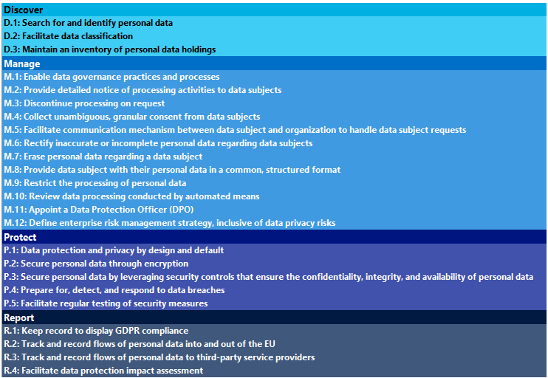
GDPR Detailed Assessment Tool - Input
Questionnaire of 150+ questions
Structured around four vital areas
Discover, identify what personal data you have and where it resides
Manage, govern how personal data is used and accessed
Protect, establish security controls to prevent, detect, and respond to vulnerabilities and data breaches
Report, execute on data requests, report data breaches, and keep required documentation
Questions have a weighting that counts towards the maturity score and stage
The tool generates recommendations and provides refences to GDPR articles
Notes:
To prepare customers for the assessment provide insight into the tool and discuss questions around the four themes.
This slides provides insight in the type of questions the customer can expect, if more detail is needed the next four hidden slides can be used.
DO NOT discuss all questions and provide too much detail in the pre-engagement meeting, it will generate questions that can better be answered during the on-site engagement.

Slide 25
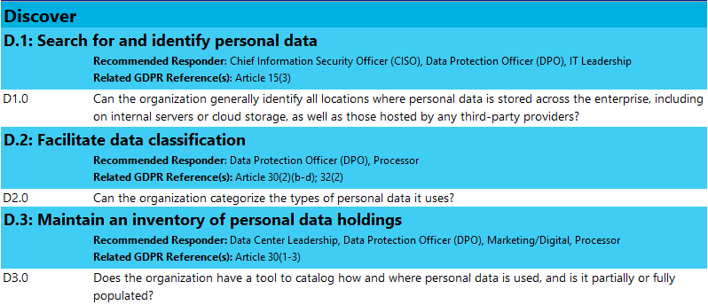
Questionnaire -Discover
Example
Notes:
This OPTIONAL slide can be included if additional detail is needed on the questionnaire, it includes the knock out questions that describe the scenario.
Unhide and present if needed

Slide 26
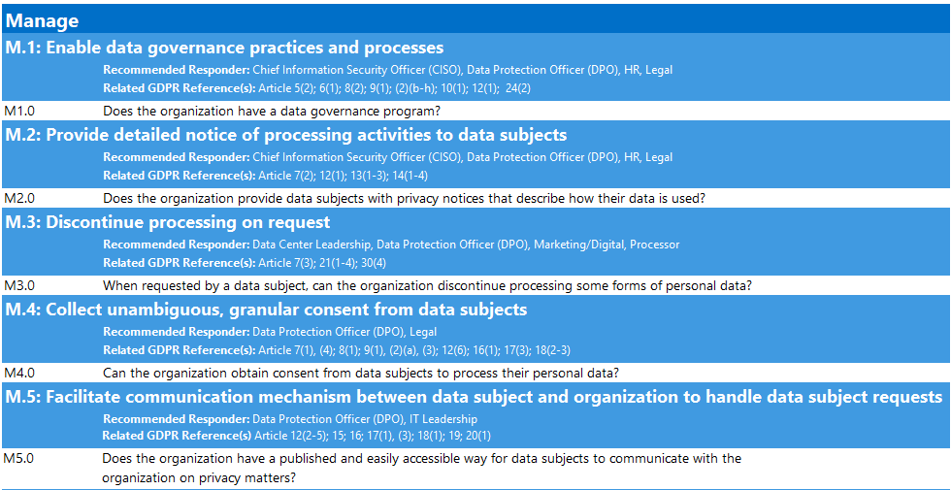
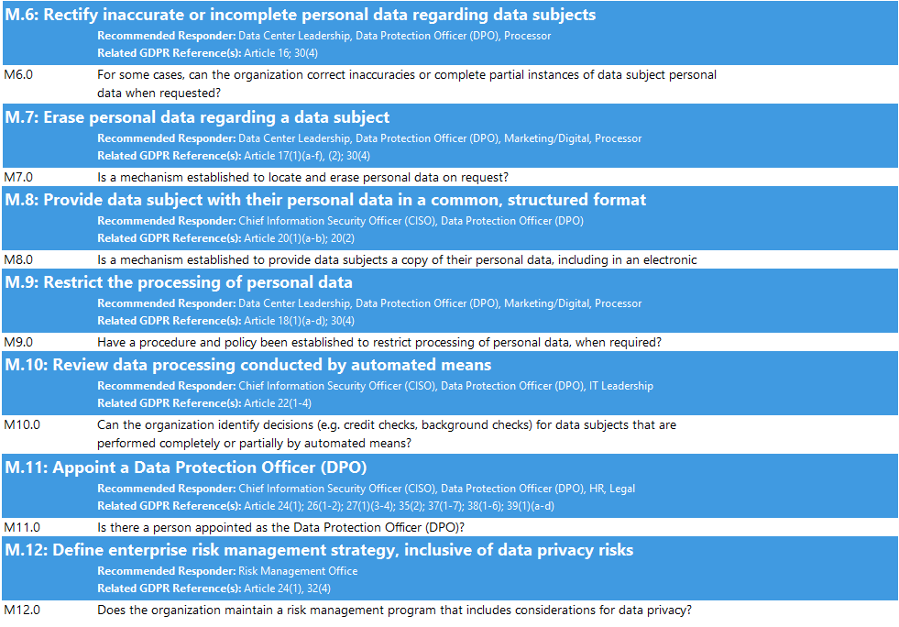
Questionnaire -Manage
Example
Notes:
This OPTIONAL slide can be included if additional detail is needed on the questionnaire, it includes the knock out questions that describe the scenario.
Unhide and present if needed

Slide 27
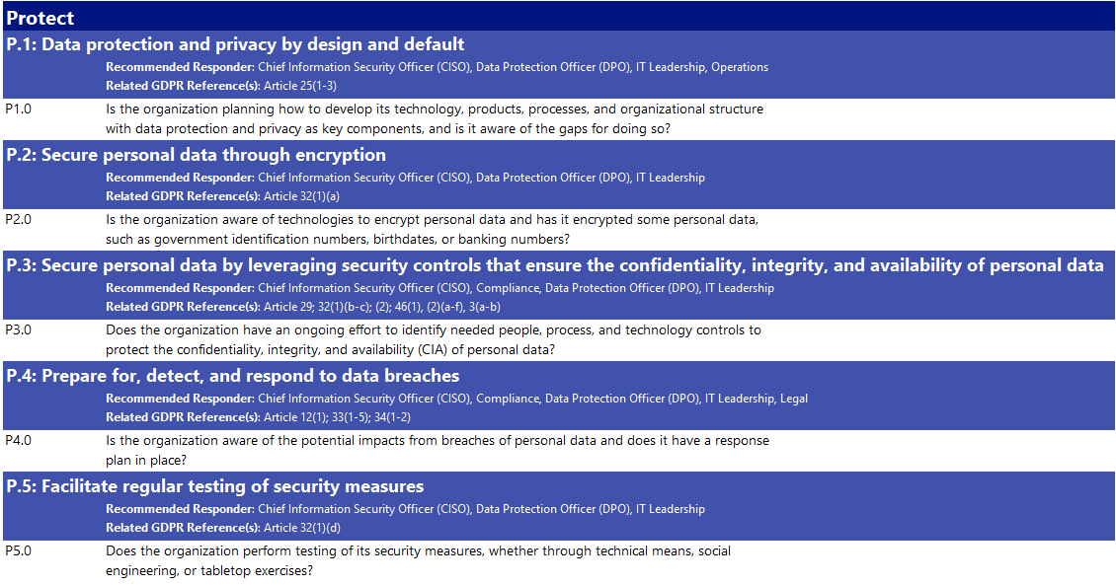
Questionnaire - Protect
Example
Notes:
This OPTIONAL slide can be included if additional detail is needed on the questionnaire, it includes the knock out questions that describe the scenario.
Unhide and present if needed

Slide 28
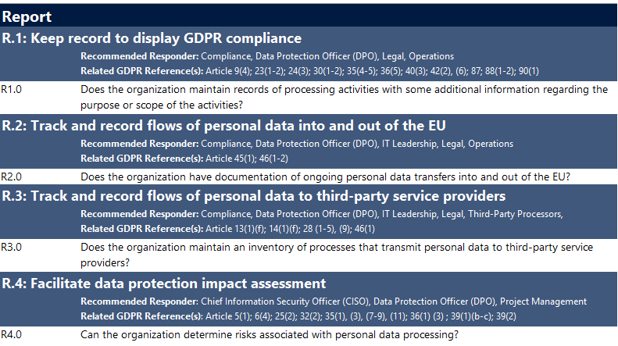
Questionnaire - Report
Example
Notes:
This OPTIONAL slide can be included if additional detail is needed on the questionnaire, it includes the knock out questions that describe the scenario.
Unhide and present if needed

Slide 29
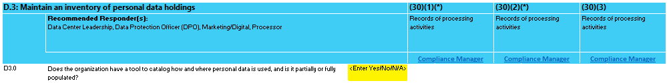
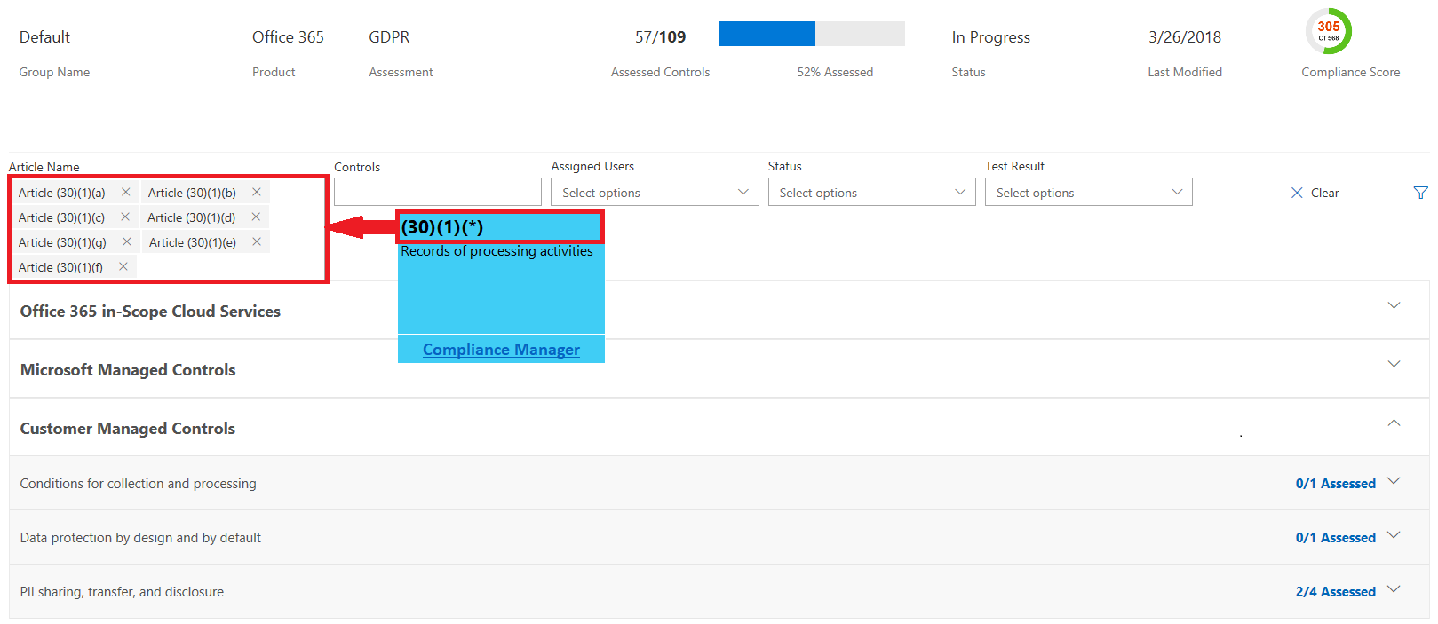
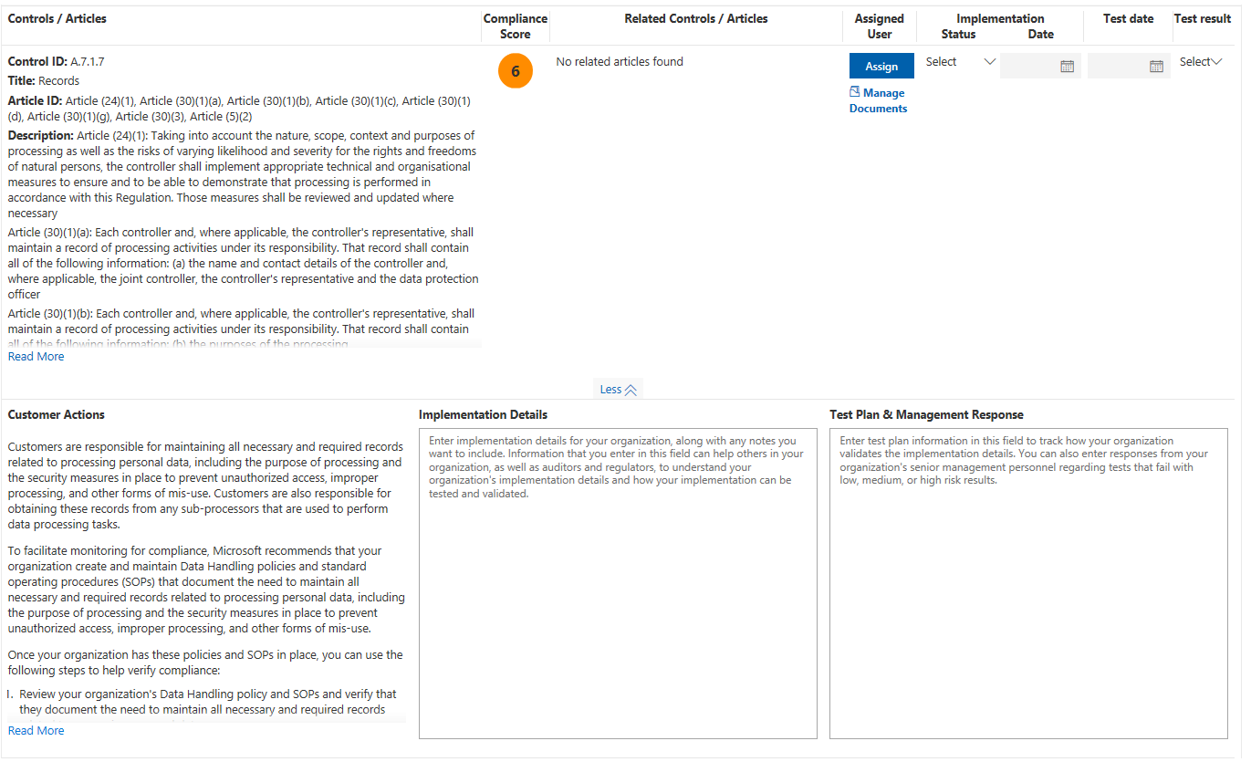
Compliance Manager integration
Optional activity
GDPR article references
Every sub-scenario provides statutory references to relevant GDPR articles
Per article links to relevant Compliance Manager controls
Compliance Manager
Real-time assessment of the GDPR compliance posture for customers assets in the Microsoft cloud
Actionable insights into both customer’s and Microsoft’s responsibility to meet compliance standards
Documented customer actions
Task delegation and assignment
Tracking and evidence gathering
Notes:
The GDPR Detailed assessment offers integration with Microsoft Compliance Manager.
For every sub-scenario under Discover, Manage, Protect and Report, the applicable GDPR articles are referenced.
For every article a link to compliance manager is provided that when clicked, will open a filtered view of the Compliance Manager dashboard. The dashboard will show both Microsoft and Customer controls that are relevant to the GDPR article referenced.
Note
Compliance manager requires a Microsoft cloud tenant. Preferably the customers production tenant is used.
Remove or hide slide if not used.

Slide 30
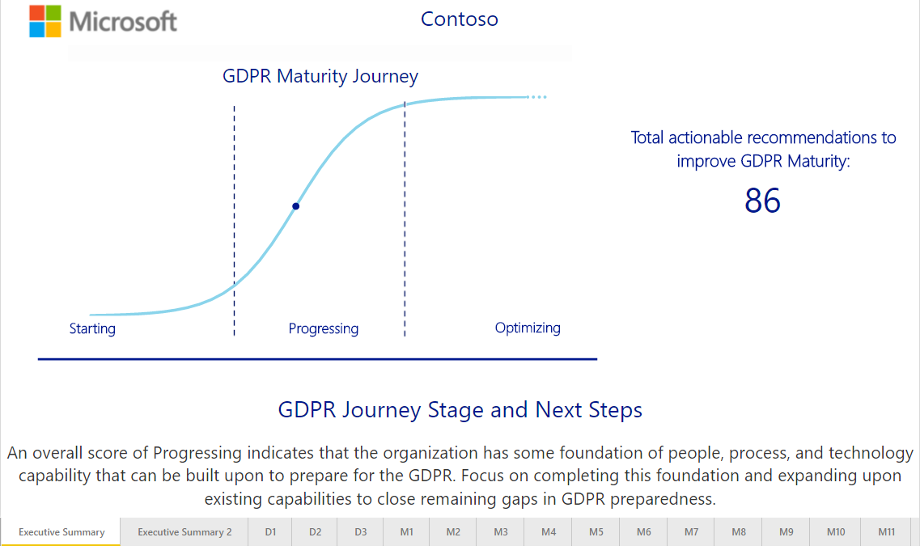
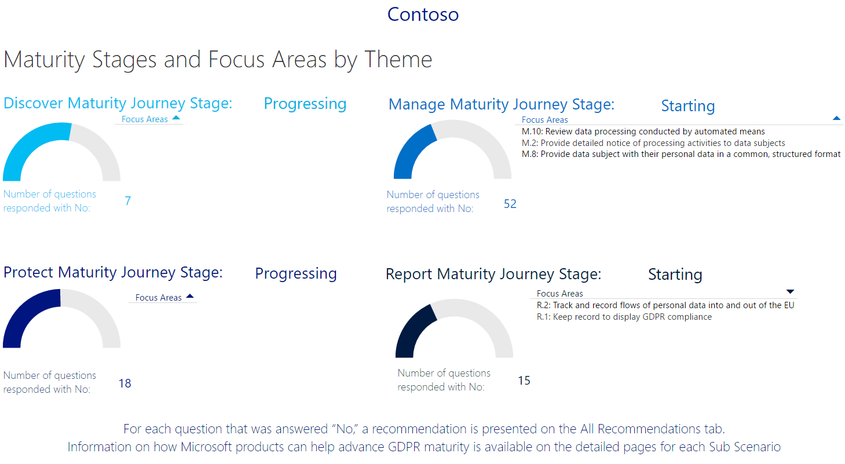
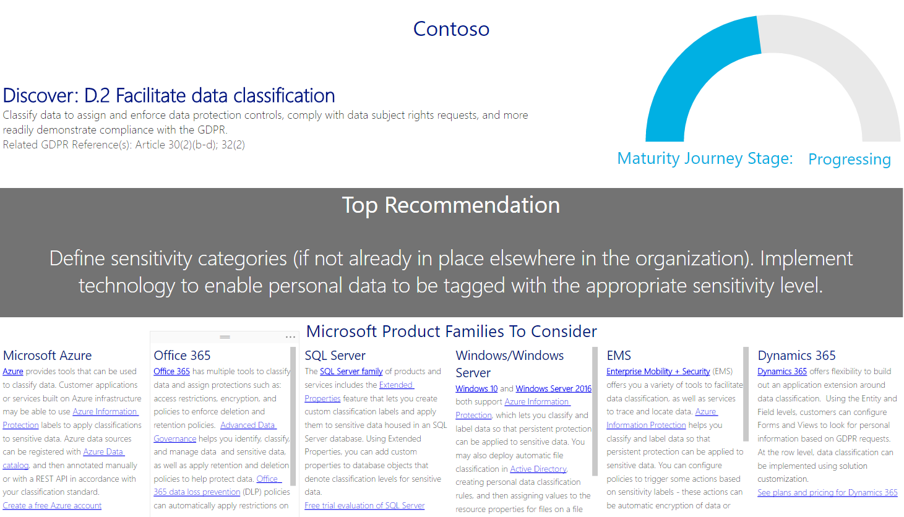
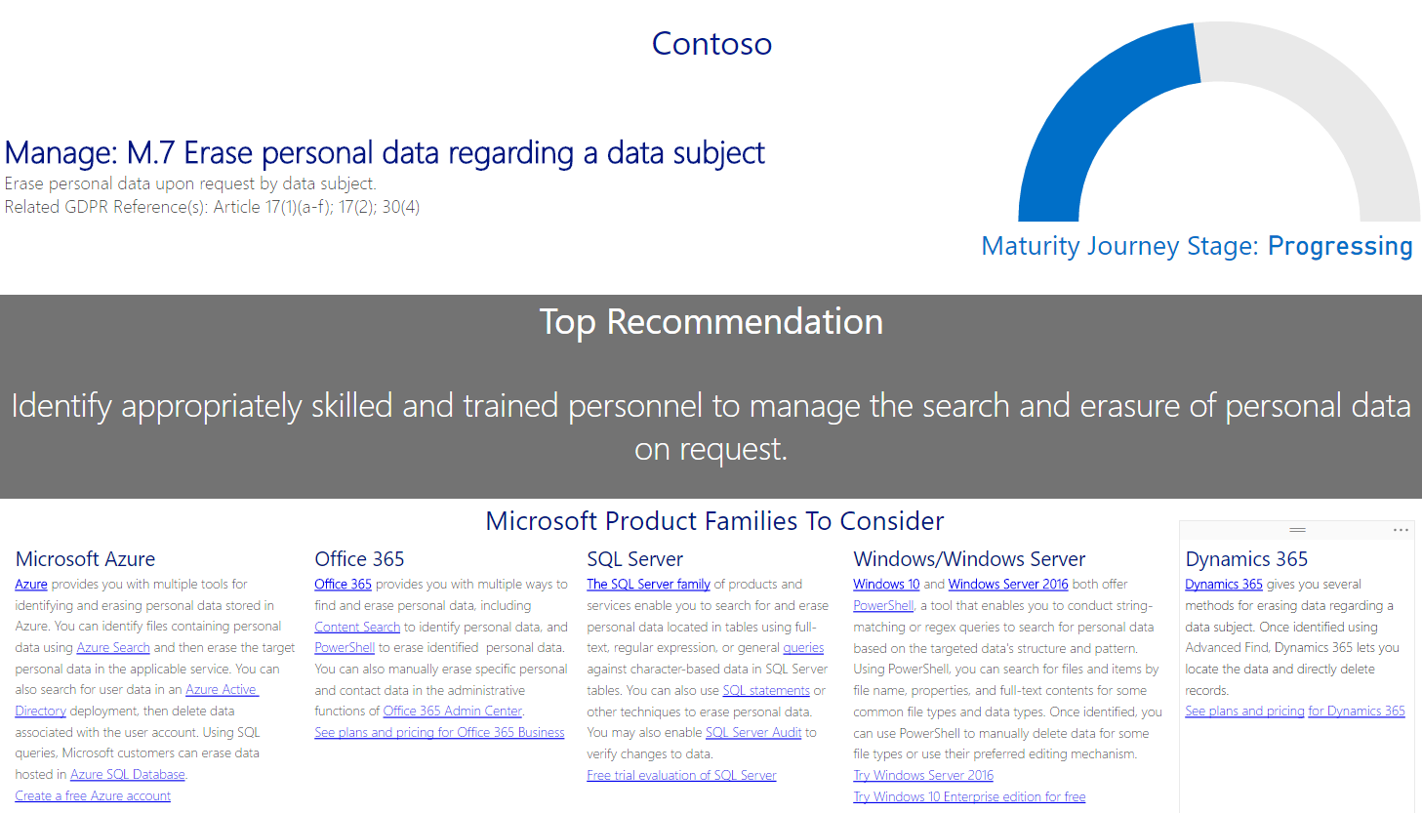
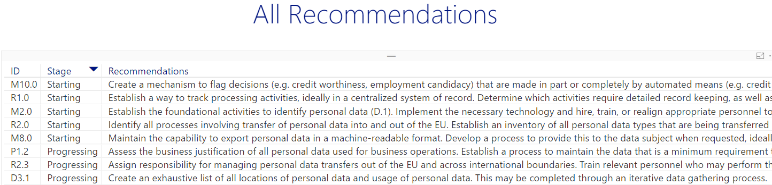
GDPR Detailed Assessment Tool - Output
Executive summary
Aggregated across all four DMPR themes
Overall maturity of one of three levels: Starting, Progressing or Optimizing
Results per theme and focus area
Detailed insights per theme
Maturity index
Top recommendation per sub scenario
Microsoft Product suggestions
All Recommendations
Comprehensive and actionable list
Full list of recommendations
Grouped by sub-scenario and GDPR maturity stage
For each theme and sub scenario
Notes:
Discuss the outcome of the tool and highlight the three types of information provided (Executive, Detailed and All Recommendation)

Slide 31
Project Governance

Slide 32
Project Governance Update
Example
Risk and issues management
Covering business, technology and project execution
Describe the escalation path
Change management
Describe the change management workflow
Success Criteria
Discuss and agree on what a successful engagement would look like
Date recorded | Risk/Issue description | Probability | Impact | Mitigation plan
Notes:
Discuss overall project governance and make sure to document risks/issues as well as success criteria for the engagement.

Slide 33
Q&A

